Slide 1
SWARM ROBOTICS AND ITS APPLICATIONS
Presented by
Chinmay Mahabal
Rutvij Pathak
Pratik Shende
Internal guide
Mrs.A.A.Mate

Slide 2
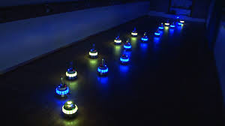
Introduction
Swarm robotics is a new approach to the coordination of multirobot systems which consist of large numbers of mostly simple physical robots. It is supposed that a desired collective behavior emerges from the interactions between the robots and interactions of robots with the environment. This approach emerged on the field of artificial swarm intelligence, as well as the biological studies of insects, ants and other fields in nature, where swarm behavior occurs.

Slide 3
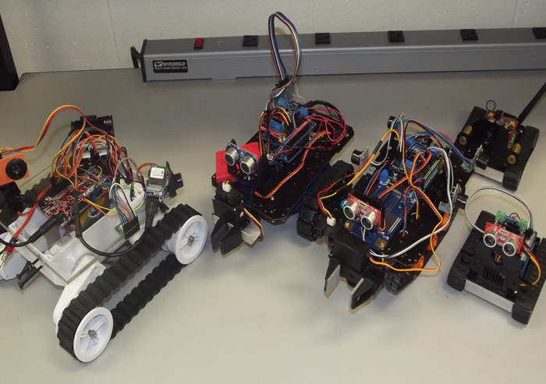
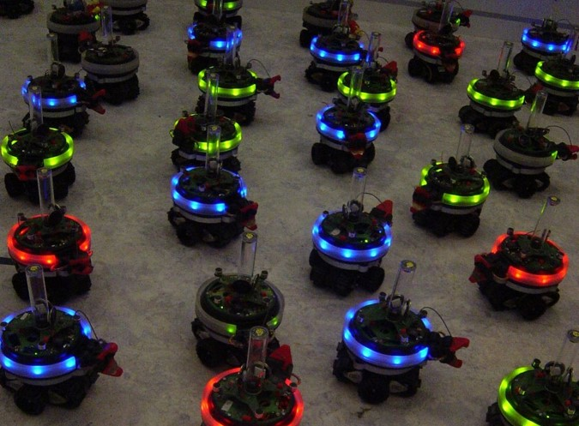
Types of Swarms
HETEROGENEOUS SWARM
HOMOGENEOUS SWARM

Slide 4

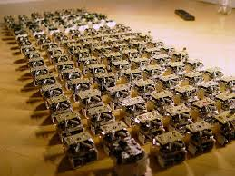
Biology to Robotics
Swarm of birds
Swarm of robots

Slide 5
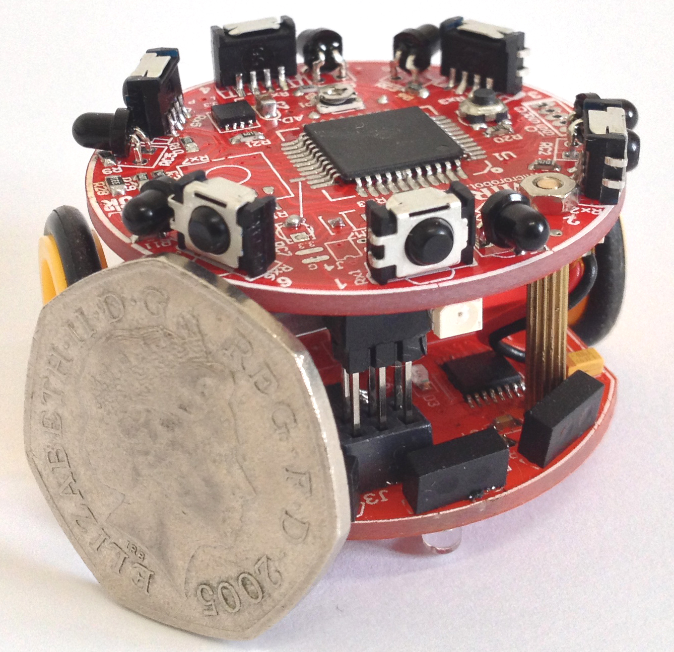
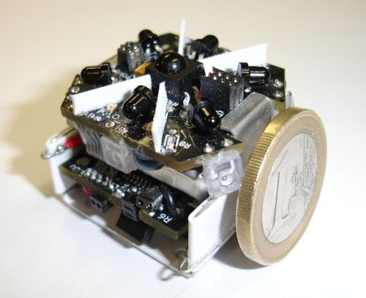
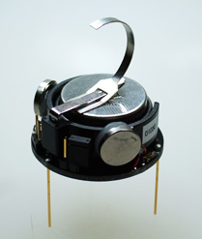
Other Swarm Robot Projects : -
Colias Project
Jasmine Swarm Robot Project
Kilobot

Slide 6
References :-
7.1 REFERENCES:
7.1.1 JOURNAL PAPERS:
[1] Y. Xinan, L. Alei, and G. Haibing, "An algorithm for self-organized aggregation of swarm robotics using timer," in Swarm Intelligence (SIS), 2011 IEEE Symposium on, 2011, pp. 1-7. [2] L. Bayindir and E. Sahin, "A review of studies in swarm robotics,"Turkish Journal of Electrical Engineering, vol. 15, pp. 115-147, 2007.
[3] Kilobot: A Low Cost Scalable Robot System for Collective Behaviors
Michael Rubenstein, Christian Ahler, Radhika Nagpal
IEEE Intl. Conf on Robotics and Automation (ICRA), 2012.
7.1.2 BOOK REFERENCES:
[1] Swarm Intelligence and Algorithms by Yuhui Shi.
[2]Muhammad Ali Mazidi, “AVR Microcontroller and Embedded System”, 14 august 2011, 1st
edition.
7.1.3 WEB
1. www.techdocs.altium.com/display/FPGA/NEC+IR+TX+PROTOCOL
2. http://www.swarm-bots.org
3. http://www.eecs.harvard.edu/ssr/projects/progSA/kilobot.html

Slide 7
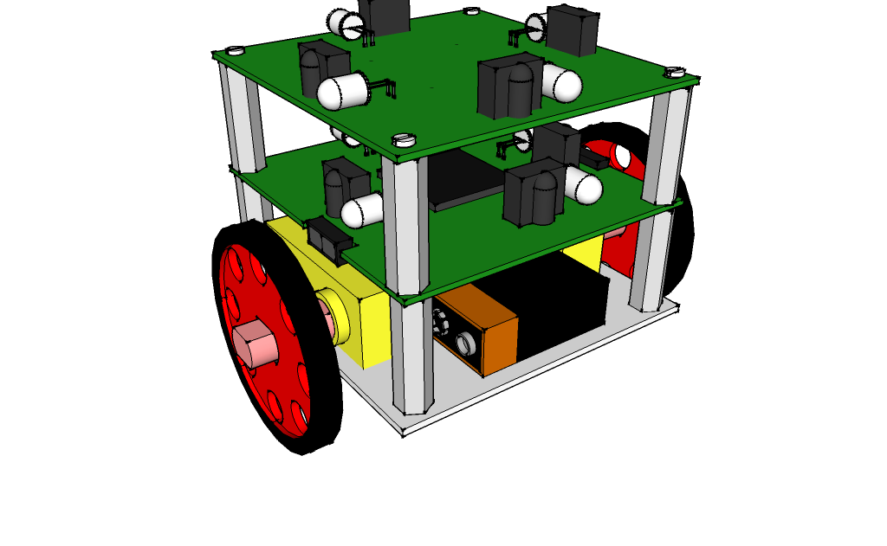
Our Goal : -
To develop a hardware platform which is simple ,cost effective and easy to manufacture .
To develop a basic autonomous agents using various algorithms and protocols ,which will lead to the development of basic A.I .
Proposed Design of the Agent

Slide 8
Block Diagram of an Agent
MAPPING
IR LED
MICROCONTROLLER
(Atmega328p)
IR RECIEVER (TSSOP)
MOTOR DRIVER
(L293D)
MOTORS
(3 V , 200 RPM)

Slide 9
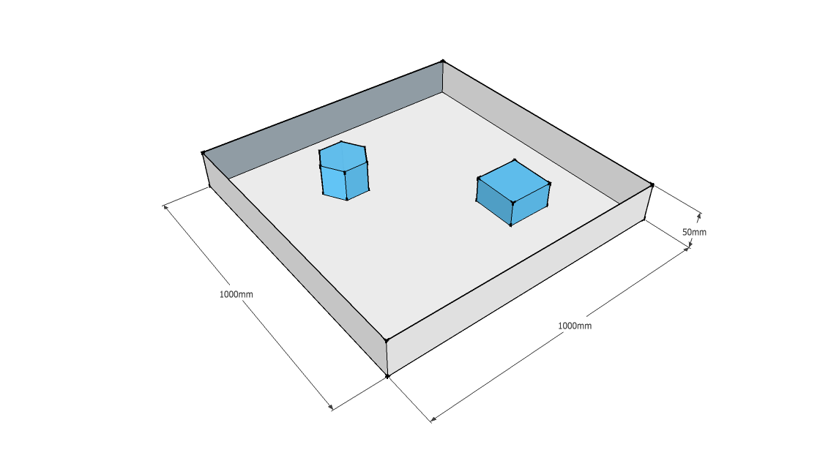
Environment
Proposed Environment for testing of the swarm

Slide 10
Environment
The environment will be constructed out polystyrene .
Various obstacles will be placed in the environment .
Figure Illustrates the proposed environment
The obstacles are represented by blue .

Slide 11
Applications
The swarm robots are used in disaster rescue and emergency situations where multiple agents (robots) are deployed in time critical situations ,where numbers are an advantage.
Swarm robots are also used in artificial intelligence research as an hardware platform to implement algorithms .

Slide 12
Applications be presented :-
Follow the leader – This indicates the ability of the group to follow without being explicitly programmed .
Cluster Formation - This is precursor to self-assembly it demonstrated the ability to organize into group .

Slide 13
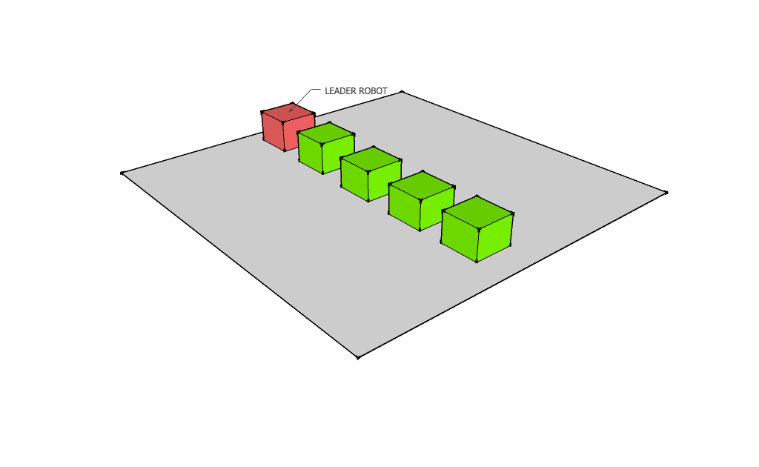
1 .Follow the leader
In this experiment the users will define a leader among the group of bots .
All the other bots will “follow the leader” by either imitating the leader robot or forming a line behind it and follow him from point A to Point B .
They will not only follow the leader’s direction but the imitate its every action.
The leader bot is designated by red .
Robots assembled behind a leader

Slide 14
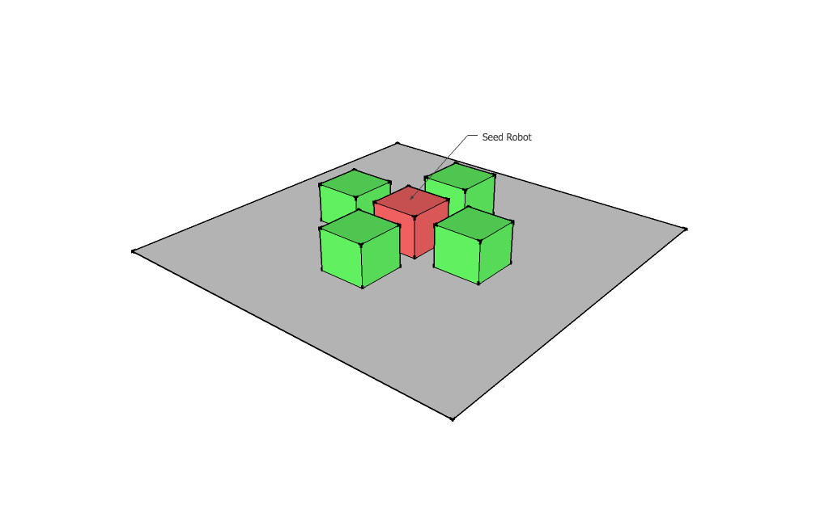
2.Cluster Formation
In this experiment the users will define a specific shape to be formed .
After receiving the command ,the robots will form a specific shape around a robot which will be considered a “seed robot ”.
The seed robot in the diagram is indicated by red .
Cluster formations are precursors for self-assembly which is an emerging field in robotics.
Example of a cluster formed a seed robot

Slide 15
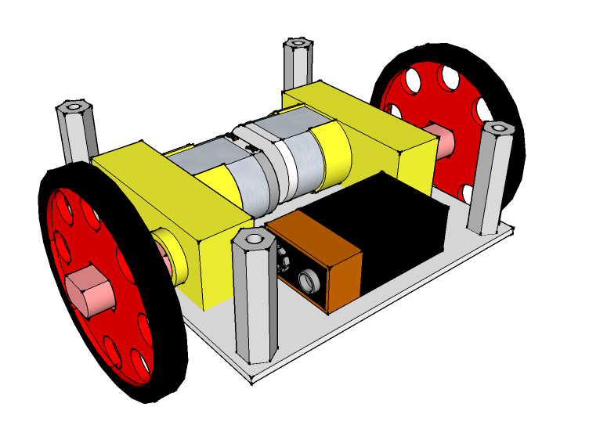
Construction of an Agent - Level 1
This level contains the base on which the entire agent will be built .
This level contains a base , 4 standoff screws , 2 motors and wheel assembly .
This is also the level on which battery will be placed , for optimum balance .

Slide 16
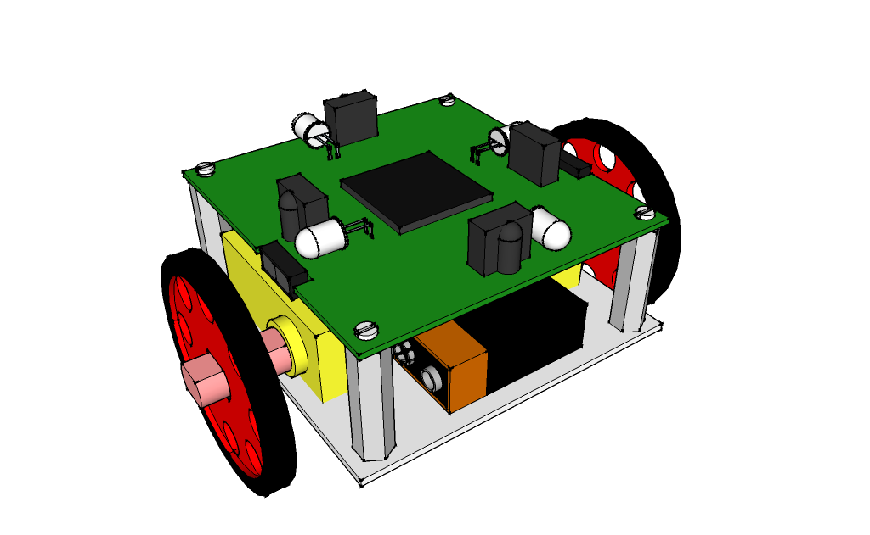
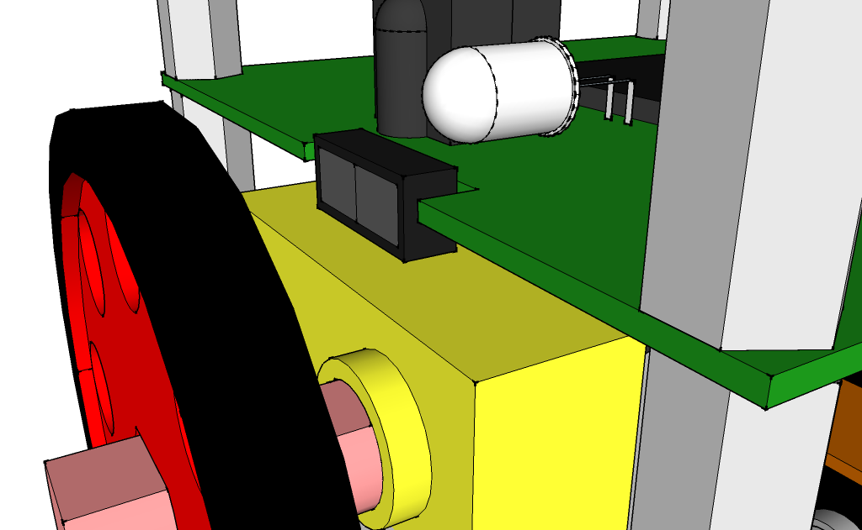
Construction of an Agent-Level 2
This level contains the main microprocessor which will be controlling the agent’s behavior .
This level has 4 pairs of transmitters and receiving IR .
These IR transmitters and receivers are used for mapping the surrounding environment .
Alternatively these can also be used for communication .
Phototransistor and IR emitter pair (VSMB10940) will be used for odometry .

Slide 17
Construction of an Agent-Level 3
This is the topmost layer of the agent.
This level contains 4 transmitters and receiver pair .
These pairs will be used for communication.
Proposed design of the agent

Slide 18
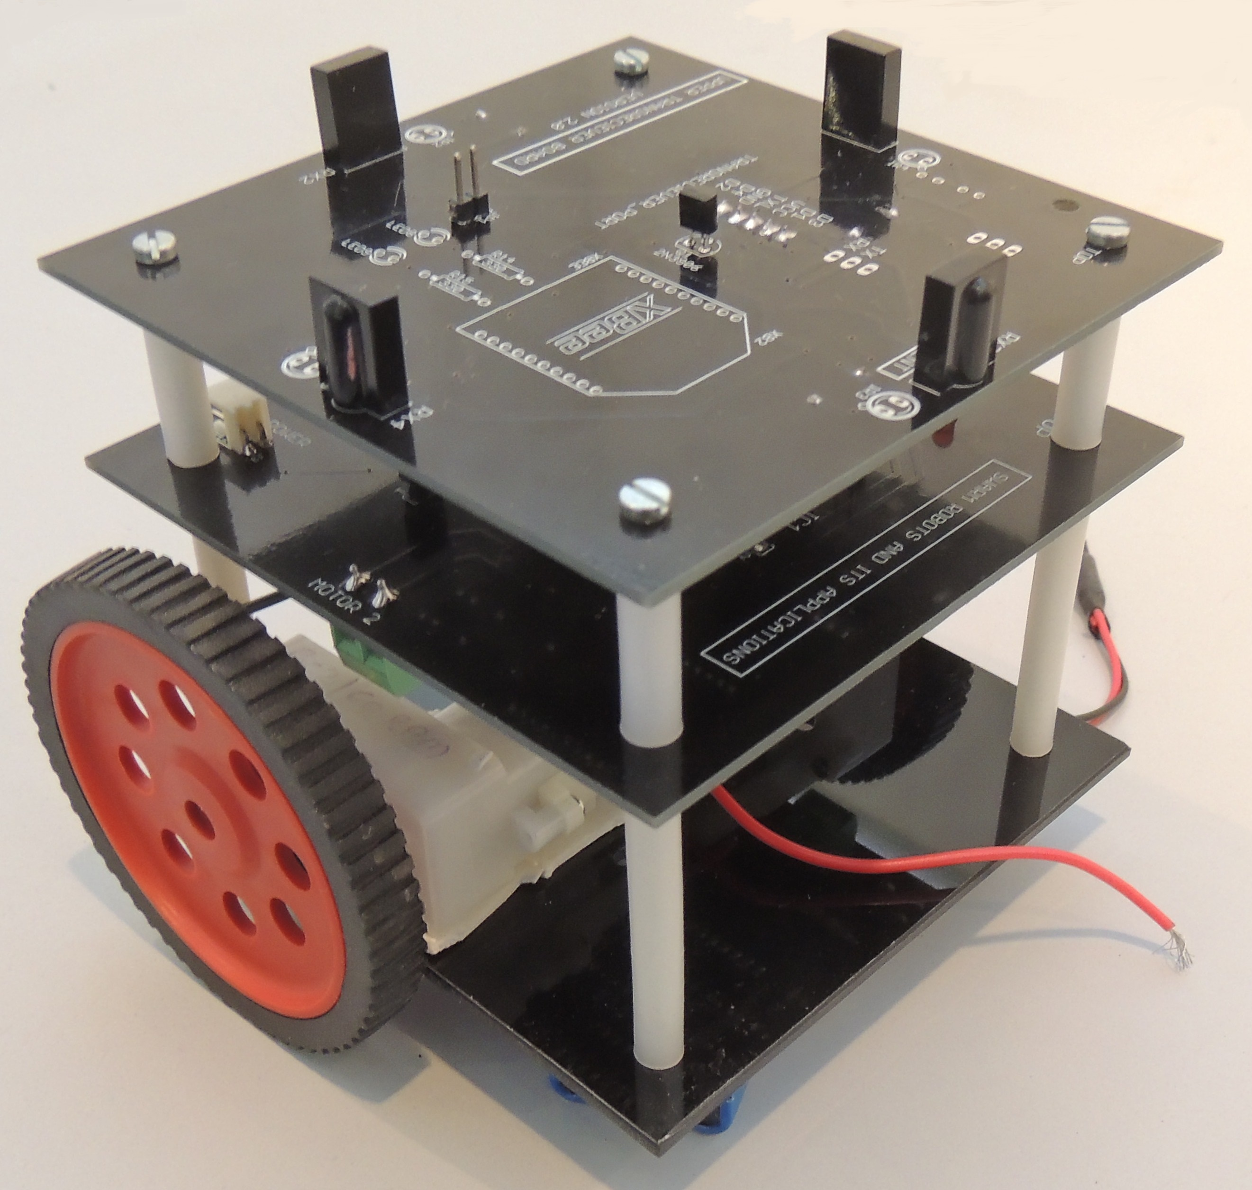
Actual Construction of an Agent

Slide 19
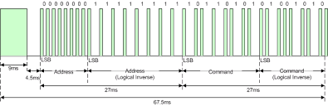
NEC Protocol
The NEC IR transmission protocol uses pulse distance encoding of the message bits. Each pulse burst (mark – RC transmitter ON) is 562.5µs in length, at a carrier frequency of 38kHz (26.3µs). Logical bits are transmitted as follows:
Logical '0' – a 562.5µs pulse burst followed by a 562.5µs space, with a total transmit time of 1.125ms
Logical '1' – a 562.5µs pulse burst followed by a 1.6875ms space, with a total transmit time of 2.25ms

Slide 20
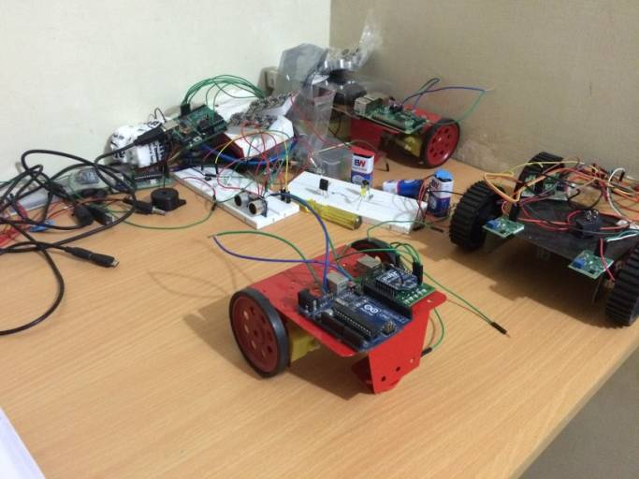
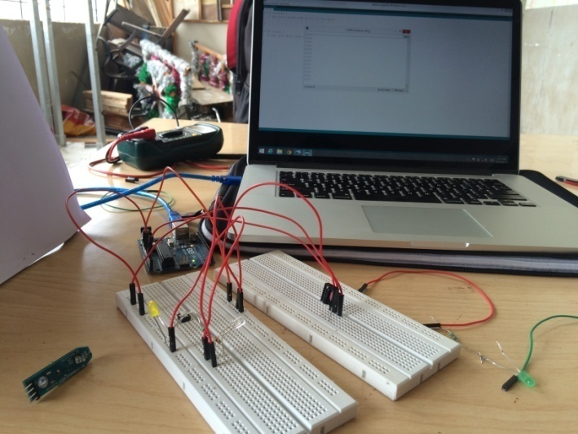
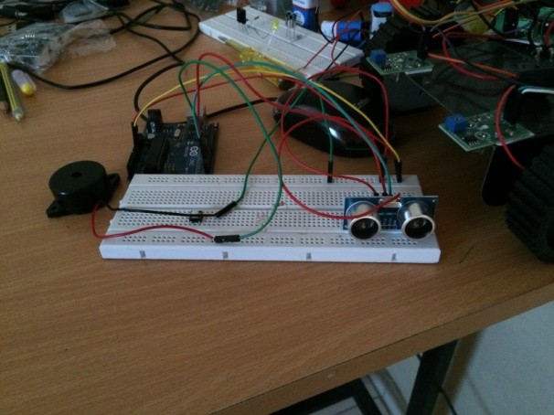
Work Done in Semester 1 :-
Tasks Completed : -
Arduino Agent assembly
Ultrasound Sensor Testing
IR communication Setup

Slide 21
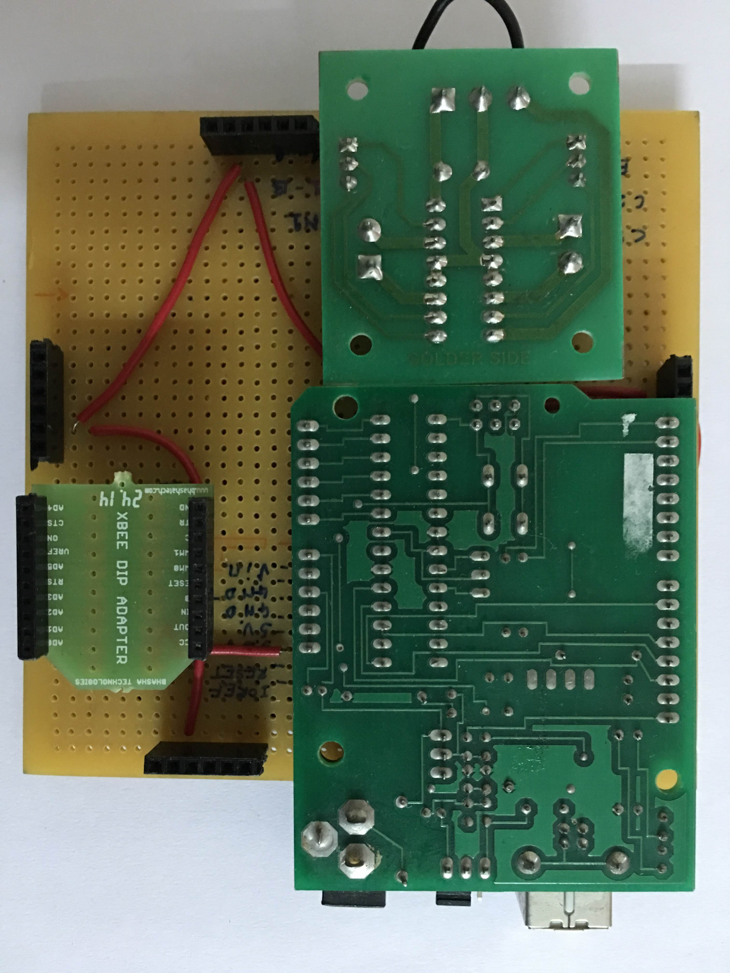
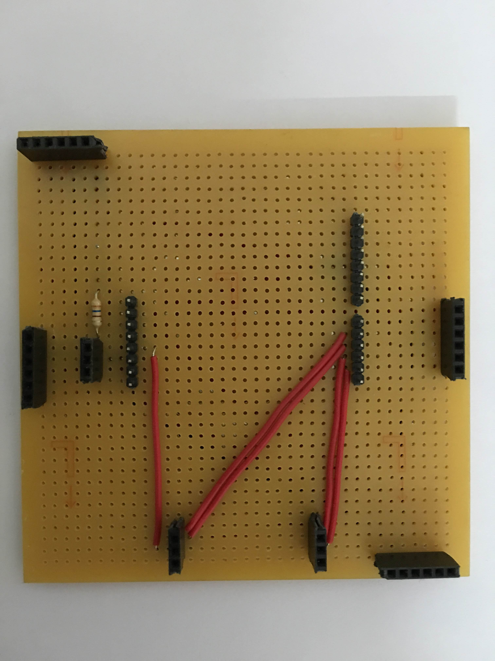
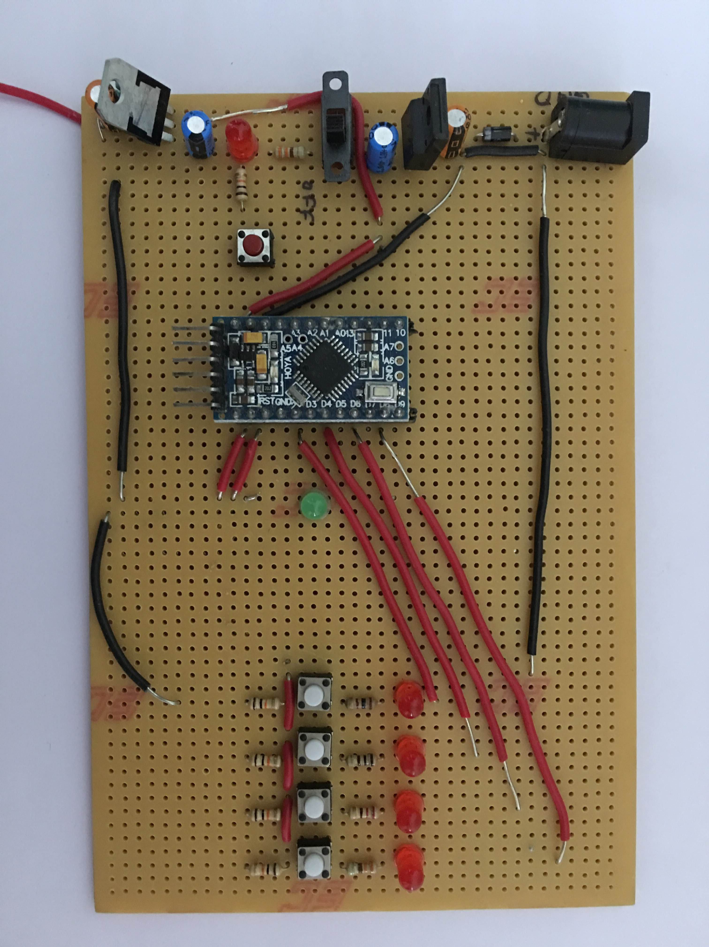
PCB (zero pcb)
Initial Zero PCB designs

Slide 22
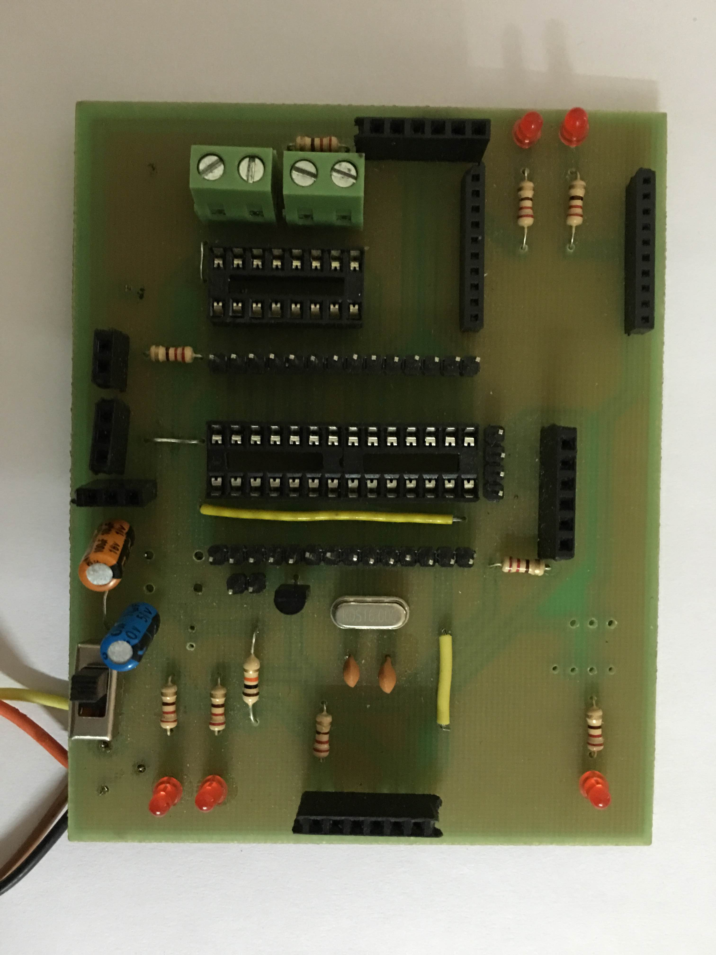
Version 1
Eagle layout of the proposed PCB
Actual Photo of the PCB

Slide 23
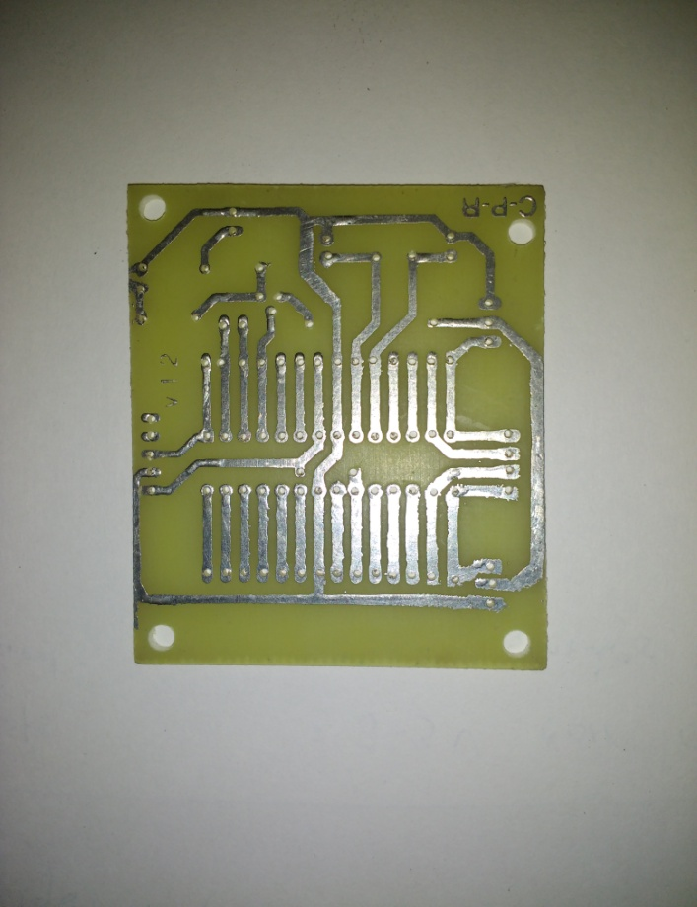
Version 2
Eagle layout of the proposed PCB
Actual Photo of the PCB

Slide 24
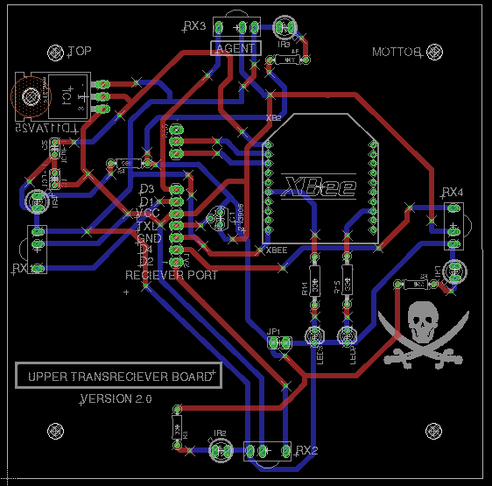
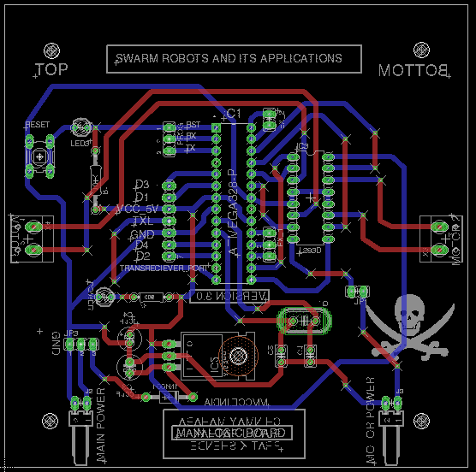
Version 3

Slide 25
Actual photo of the final Agent

Slide 26
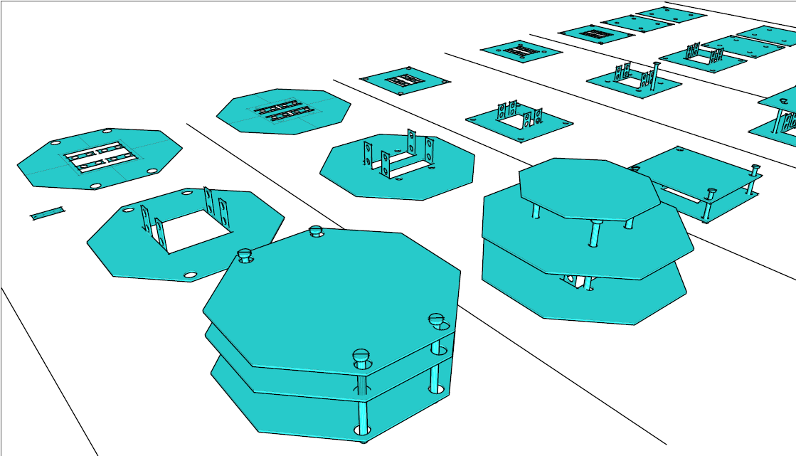
Various Iteration of the base of the agents

Slide 27
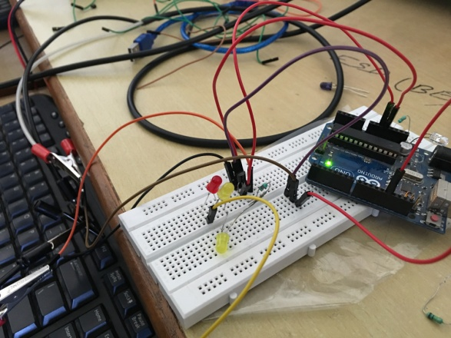
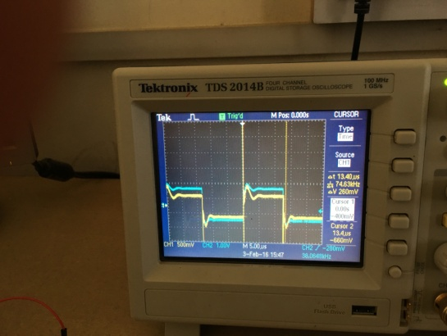
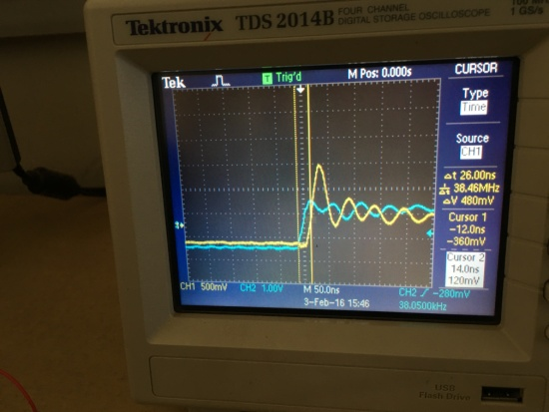
Transistor Testing Setup
Transistor testing assembly
Input output Waveform Comparison
Transistor triggering delay measured

Slide 28
THANK YOU !

